Slide 1

Fundamentals of Electric Transmission System Planning Short Course
Transmission Planning
José Conto
ERCOT
Presented by Tracy Rolstad
© copyright José Conto, 2019

Slide 2
Transmission Planning
Any transmission system like the SDG&E in CA, New England Independent System Operator or ERCOT Interconnection shall plan for their future operating conditions.
Generation capacity change due to retirements or new interconnections.
Transmission projects can bring new lines or upgrade elements like reactive resources.
Load would usually increase, bringing a variety of load behavior.
Electricity supply shall always be in balance with demand, in active and reactive power.
A planning process allows to modernize the electric network to ease congestion, allow for increases in demand, and provide an acceptable degree of reliability.
Notes:
Electricity is a cornerstone on which the economy and the daily lives of our nation’s citizens depend. This essential commodity has no substitute. Unlike most commodities, electricity cannot easily be stored, so it must be produced at the same instant it is consumed. The electricity delivery system must be flexible enough, every second of the day and every day of the year, to accommodate the nation’s ever changing demand for electricity

Slide 3
Transmission Planning Basics Tasks
Develop and maintain methodologies, criteria and tools for the analysis and simulation of the transmission system.
Develop, acquire and validate information required for transmission assessments including:
Transmission Facility characteristics and Ratings;
Demand and Electrical Energy forecasts, capacity resources, and Demand-Side Management (DSM) programs;
Generator unit performance characteristics and capabilities;
Commitments for firm Transmission Interchange; and
Load forecasts and generation dispatch scenarios.
Develop and maintain power system models (steady state, dynamics, and short circuit) necessary for the assessment of the transmission system performance for identified scenarios.
Exchange information with other transmission planners and the Planning Coordinator to achieve an interconnected model.
Assess the performance of the transmission system with the anticipated topology and scenarios of loads and resources
Feed the NERC Mandatory Reliability Compliance machine
Notes:
Electricity is a cornerstone on which the economy and the daily lives of our nation’s citizens depend. This essential commodity has no substitute. Unlike most commodities, electricity cannot easily be stored, so it must be produced at the same instant it is consumed. The electricity delivery system must be flexible enough, every second of the day and every day of the year, to accommodate the nation’s ever changing demand for electricity

Slide 4
Transmission Planning Overview
Transmission Planning
Planning Assessments
Near Term planning (RTP)
System Development & dynamic studies
Voltage and Dynamic stability assessments
RPG project reviews, RMR studies
Long-term planning (LTSA) & Economic analysis

Slide 5
Planning Network Model Building
ERCOT/TSP Network Model
NMMS
Topology Processor
CRR Top Output
Complete TP Output
TSP Review
ERCOT
Gen Dispatch
Profile
ERCOT
Model on Demand
Planning Case Output
Topology from Existing Planning Case
SSWG Approve
TSPs submit
changes
No
TSP Load,
Voltage
Profiles
Yes
TSP Future models
Case Posted

Slide 6
Relevant Standards
NERC Standards
Steady state portion of the NERC reliability standard TPL-001 “Transmission System Planning Performance Requirements”.
ERCOT Planning Guides
ERCOT Planning Guide Section 3.1.1.2 – Guidelines to perform RTP
Planning Guide Section 4 – Planning Criteria
ERCOT Protocols
ERCOT Protocols Section 3.10.8.4 (3) – Requirement to identify additional Transmission Elements that have a high probability of providing significant added economic efficiency to the ERCOT market through Dynamic Rating and request such Dynamic Ratings from the associated ERCOT TSP.
ERCOT Protocols Section 3.11.5 – Economic planning criteria

Slide 7
Planning Reliability Criteria
Steady State
0.95 per unit to 1.05 per unit in the pre-contingency state
0.90 per unit to 1.05 per unit in the post-contingency state of NERC contingency P1 to P7
Voltage stability margins
PV margin of 5% or larger for NERC contingency P0 and P1
PV margin of 2.5% for NERC contingency P2 to P7
Transient voltage response
Voltage shall recover to 0.90 p.u. within five seconds after clearing the fault for NERC contingency P1
Voltage shall recover to 0.90 p.u. within ten seconds after clearing the fault for NERC contingency P1 to P7
Damping criteria
Power oscillation within the range of 0.2 Hz to 2 Hz decays with a minimum 3% damping ratio for NERC contingency P1 to P7.

Slide 8
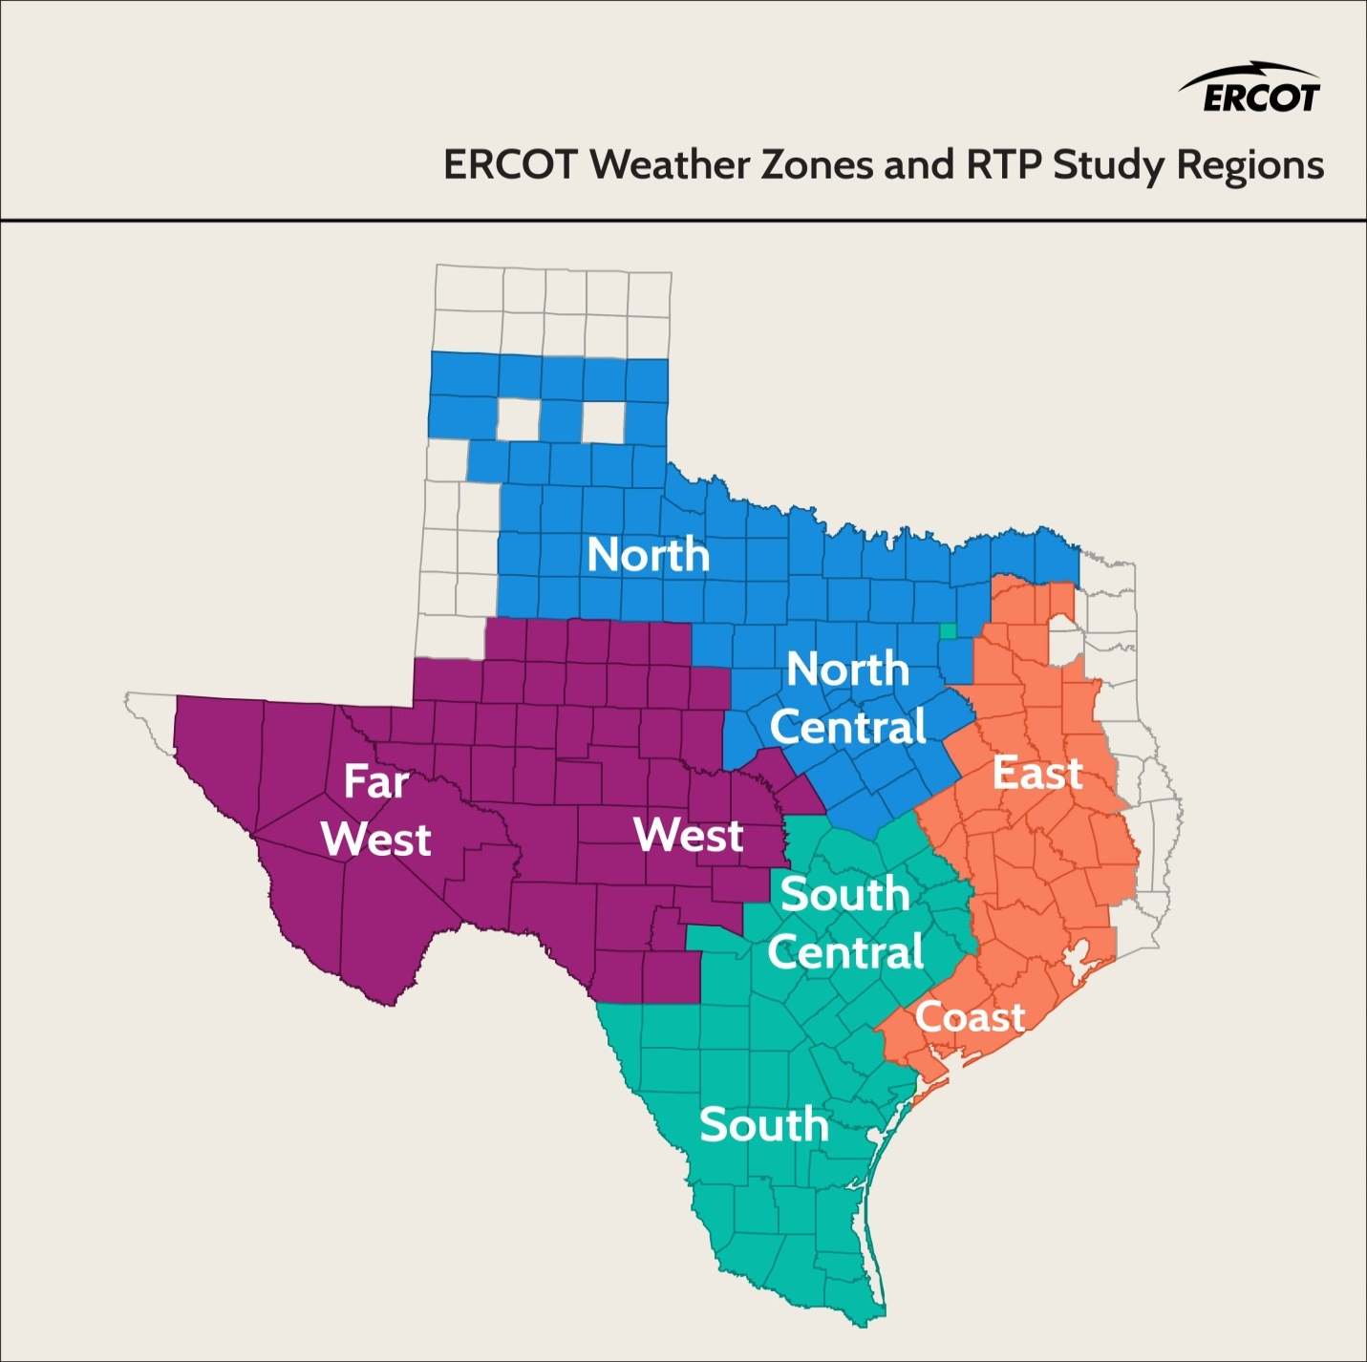
Weather Zones and Study Regions

Slide 9
Regional Transmission Plan (RTP)
Steady-state region-wide reliability and economic transmission needs
Identifies planned improvements for next six years
Developed annually in coordination with the Regional Planning Group (RPG) and Transmission Service Providers (TSPs)
Planning Coordinator Responsibilities
NERC Reliability Standards (TPL-001-4)
ERCOT Protocols, Operating Guides and Planning Guides (Sections 3 and 4)

Slide 10
Why prepare RTP?
System wide planning assessment for the ERCOT grid – instead of the region specific look by the TOs
Reliability and economic start cases for most of the ERCOT independent reviews and ad-hoc projects
TOs refer to the RTP studies while preparing for PUCT reviews of their proposal
Serves as Planning Coordinator (PC) responsibility towards NERC Reliability Standard TPL-001-4

Slide 11
RTP Overview
RTP
Contingency analysis and SCOPF
Short Circuit analysis
Long lead time assessment
Sensitivity analysis
Multiple element outage analysis
Cascade analysis
Economic analysis

Slide 12
RTP Process
Case Conditioning
Future transmission and generation review and update
Transmission Outages, Dispatch of variable generators and limit monitoring settings
Basecase Reliability Analysis
N-1 SCOPF (P0, P1 and P7)
Additional Reliability Analysis
Multiple element outage analysis and extreme event analysis
Sensitivity analysis for at least 2 summer peak cases and 1 off-peak case
Load review and adjustment
Generator and Transformer outage analysis (P3 and P6-2)
Contingency Analysis for certain (P2, P4 and P5) EHV contingencies
Add or improve transmission projects to mitigate overloads
Long-lead time equipment analysis
Short circuit analysis
Economic Analysis
Perform economic analysis
Add or improve transmission projects that meet the economic criteria

Slide 13
Generation Assumptions
Existing and new generation
MB generation (treated as being on outage)
Wind generation (dispatched based on historical data – use 15th percentile capacity factor during the top peak load hours )
Hydro generation (Dispatched based on historical data)
Solar (dispatch at 70% max MW)
New generation must have the following:
Signed Standard Generation Interconnection Agreement (SGIA)
Air and water permit if necessary (approved by Texas Commission on Environmental Quality)
See planning guide section 6.9 for new generation requirements
Control options (AGC, Fast Start, AVR, Enforce MW Limits)
Cost curves imported from UPLAN

Slide 14
Transmission assumptions
Projects to include in cases:
Projects approved by the ERCOT Board
Projects previously reviewed by the RPG
New projects by TSPs in order to complete RPG review
Local projects currently planned by TSPs
The latest SSWG summer peak base cases and the SSWG min case are used as start cases
Remove all Tier 1, 2 and 3 projects that have not undergone RPG Project Review
Add any transmission outages that may be available for the study time frame
DC Ties
Based on historical data examine the DC ties flows to make sure they are still exporting or importing as the historical data

Slide 15
Load Assumptions
Evaluate the loads by weather zone
Nonconforming or Conforming
Bounded higher methodology used to choose between the aggregated weather zone load based on SSWG or the ERCOT 90th percentile weather zone load forecast
90/10 forecast ensures 90% confidence that the load will come in lower than predicted during peak
90/10 forecast targets to stress the system and make sure that you are prepared for almost all unforeseeable system load conditions
Load and reserve requirement met by
Turning up wind generation outside study region to CDR levels
Scaling down loads outside study area

Slide 16
Limits and Monitoring
Monitoring
All transmission elements (excluding generator step-up transformers) 60-kV and above for thermal constraints
Rate A is used for pre-contingency and Rate B is used for post contingency limits
All buses 100-kV and above are monitored for voltage analysis
Ratings and SOL
TPs provide facility ratings via SSWG cases
In summer peak cases RTP uses temperature adjusted ratings based on 90th percentile temperatures for a weather zone
Per ERCOT SOL Methodology:
0.95 per unit to 1.05 per unit in the pre-contingency state (and with all facilities in service in the planning horizon)
0.90 per unit to 1.05 per unit in the post-contingency state

Slide 17
Contingencies
Category | Initial Condition | Event |  | Load Shedding allowed?
 |  |  |  | EHV | HV
P0 | System intact | None |  | N | N
P1-1 | System intact | G-1 (generator) |  | N | N
P1-2 |  | T-1 (transmission) |  | N | N
P1-3 |  | X-1 (transformer) |  | N | N
P1-4 |  | S-1 (Shunt device including FACTS devices that are connected to ground) |  | N | N
P1-5 |  | DC |  | N | N
P2-1 | System intact | Open Line (one-end of the line) W/O Fault |  | N | N
P2-2 |  | BS (Bus section fault) |  | N | Y
P2-3 |  | NBTB (Internal failure of non-bus tie breaker) |  | N | Y
P2-4 |  | BTB (Internal failure of bus tie breaker) |  | Y | Y
P3-1 | G-1 + System Adjustment | G-1 (generator) |  | N | N
P3-2 |  | T-1 (transmission) |  | N | N
P3-3 |  | X-1 (transformer) |  | N | N
P3-4 |  | S-1 (Shunt device including FACTS devices that are connected to ground) |  | N | N
P3-5 |  | DC |  | N | N
P4-1 | System intact | Stuck Breaker of non-bus-tie breaker (NBTB) for the fault associated with | G-1 | N | Y
P4-2 |  |  | T-1 | N | Y
P4-3 |  |  | X-1 | N | Y
P4-4 |  |  | S-1 | N | Y
P4-5 |  |  | BS | N | Y
P4-6 |  | Stuck Breaker of bus-tie breaker (BTB) for the fault associated with | BS |  | Y
P5-1 | System intact | Failure of non-redundant relay for the fault associated with | G-1 | N | Y
P5-2 |  |  | T-1 | N | Y
P5-3 |  |  | X-1 | N | Y
P5-4 |  |  | S-1 | N | Y
P5-5 |  |  | BS | N | Y
P6-1 | N-1 + Adjustment | T-1 (transmission) |  | Y | Y
P6-2 |  | X-1 (transformer) |  | Y | Y
P6-3 |  | S-1 (Shunt device including FACTS devices that are connected to ground) |  | Y | Y
P6-4 |  | DC |  | Y | Y
P7-1 | System intact | Two adjacent circuits on common structure. (exclude if 1 mile or less) |  | Y | Y
P7-2 |  | Loss of a bipolar DC |  | Y | Y

Slide 18
Tools and Techniques
Powerworld : To perform SCOPF and Contingency Analysis
PSSE: To perform Short Circuit Analysis and for case conditioning to run idevs from TOs
UPLAN: To run economic analysis
POM Software: Perform multiple element outage analysis (Load shed and Cascade analysis)
V&R Energy
TARA: Transformer and Generator Outage Analysis
PowerGEM
In-house Scripts using SimAuto

Slide 19
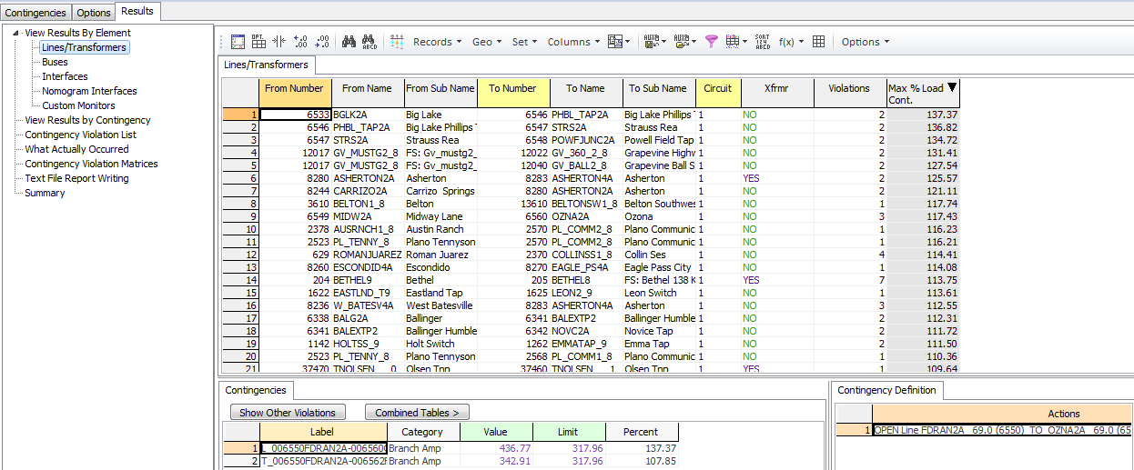
Contingency Analysis
Contingency analysis checks for the security of the steady-state system (i.e. in PowerWorld):
The program will take out of service each piece of equipment, one-by-one
Resolve the power flow (Full Newton)
Check if elements have exceeded their rated capacity

Slide 20
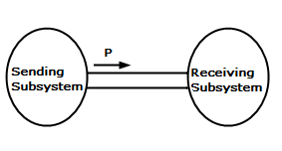
ATC Analysis
Available Transfer Capability (ATC) analysis checks the power transfer capability (import or export) of a region until a thermal violation is reached, in the steady-state system.
Process:
Power transfer between two study zones is increased and at each step, contingencies are independently applied, followed by a load flow solution.
The transfer level and associated contingency is flagged as a thermal violation scenario when the load flow causes violations on the monitors elements.
Repeat for higher power transfer level until the base case does not converged, or the source zone reaches its maximum specified exporting generation capacity.
Application:
Generation Interconnection Screening studies

Slide 21
QV Analysis
QV analysis checks for the bus reactive requirements in the steady-state system.
Modeling:
Set up a power flow case representing the system in post-disturbance
Identify a test bus. This is usually the most reactive deficient bus.
Apply a fictitious synchronous condenser at the critical bus.
Running:
Vary the condenser scheduled voltage for a range (i.e.: 1.05 pu to 0.7 pu, decrements of 0.1)
Solve the power flow
Store the reactive output of the condenser (Q) and its voltage schedule (V)
Plot Q v. V and repeat for different buses and contingencies.
These are fast so random bus selection and go in PWS?

Slide 22
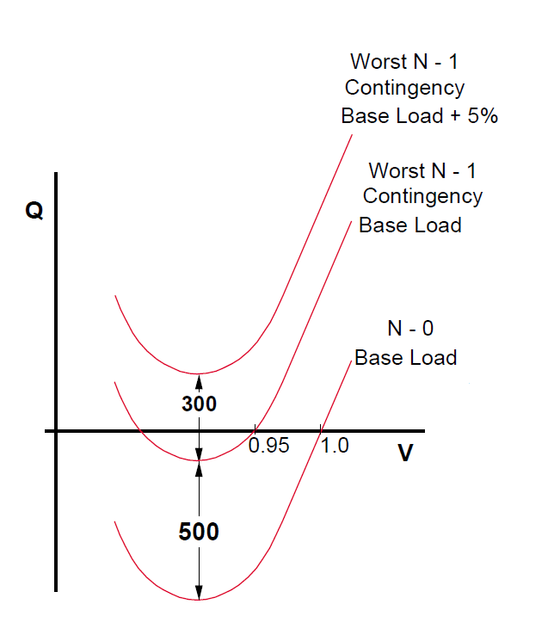
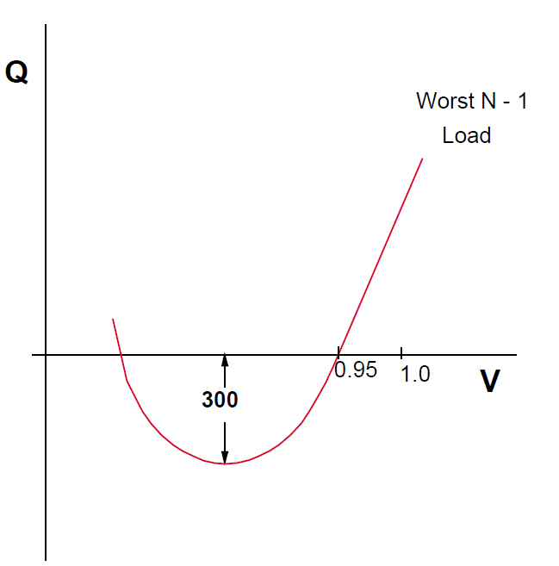
QV Analysis (2)
Analysis:
If the minimum point of the V-Q curve is above the horizontal axis, the system is reactive power deficient.
If the critical point is below the horizontal axis, the system has some margin.

Slide 23
PV Analysis
PV analysis (also referred as voltage stability study) checks the power transfer capability (import or export) of a region until voltage collapse is reached, in the steady-state system.
Process:
Power transfer between two study zones is increased and at each step, contingencies are independently applied, followed by a load flow solution.
The transfer level and associated contingency is flagged as a voltage collapse scenario for those scenarios where the load flow does not converge.
Repeat for higher power transfer level until the base case voltage collapses under no contingency, or the source zone reaches its maximum specified exporting generation capacity.

Slide 24
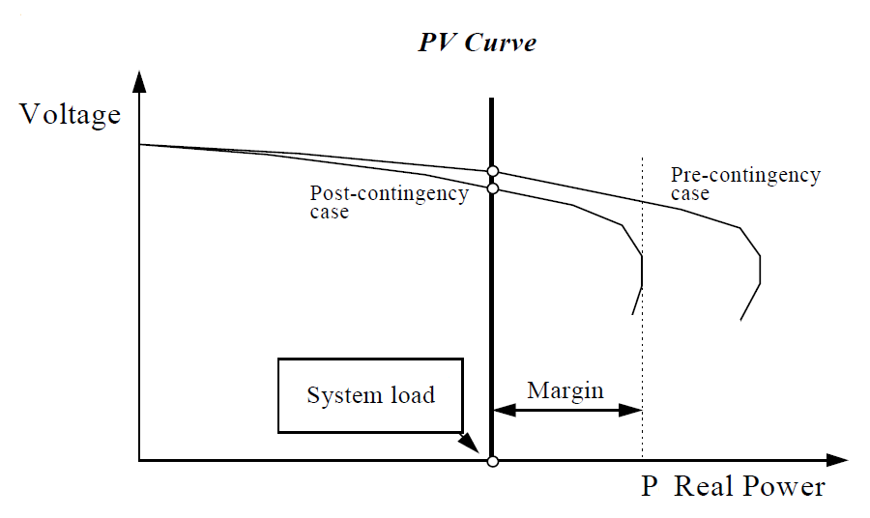
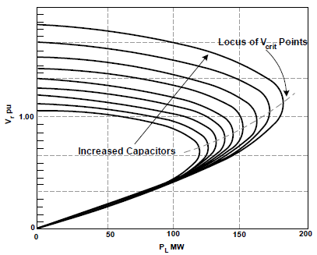
PV Analysis (2)
Analysis:
The results of the PV analysis will often indicate that the voltage profile of a region will be significantly lower than acceptable operating conditions at the point-of-collapse.
PV margins lower than those specified in the grid code indicate a need to provide additional reactive support to the region under study.

Slide 25
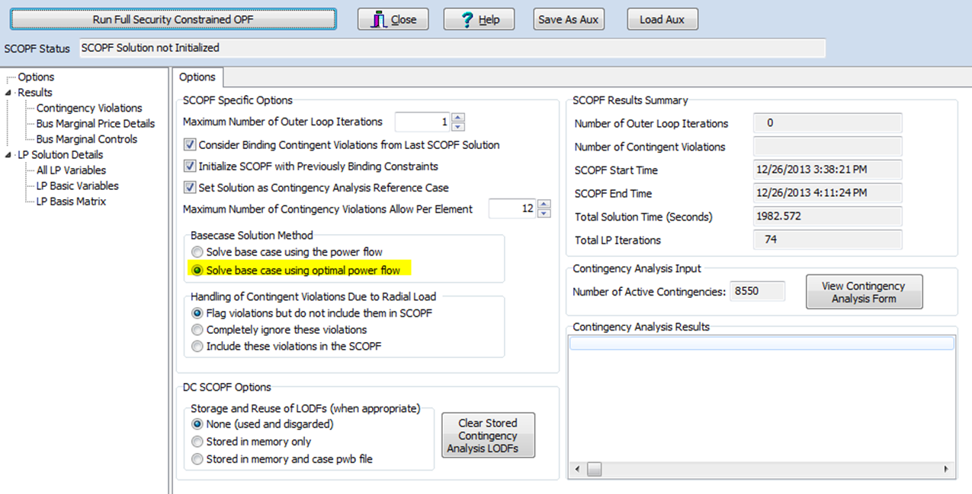
Security Constrained Optimal Power Flow (SCOPF)
SCOPF does the following:
Optimize(minimize generation cost) the objective function by taking into consideration the constraints (contingencies and limits of the system)
SCOPF will be run in order to redispatch and identify unresolvable constraints.
Looks for one overall best single dispatch and not separate ones.
Taking the contingencies into consideration, SCOPF will redispatch generation economically to minimize the constraints placed on the system.

Slide 26
N-1 Analysis
Run CA and SCOPF on conditioned cases
Post initial cases and initial set of violations
TSPs provide feedback on validity of violations and possible solutions
Model approved RAS schema
Projects to resolve thermal overloads and voltage violations
Only model those projects needed by the study case(s)
Resolve voltage violations by adjusting switch shunts and transformer tap settings
Propose new projects if necessary

Slide 27
Transformer and Generator Outage Analysis
Purpose: Test the impact of P3 or P6-2 contingency events
Process:
P3 and P6-2 are multiple element outages which
Allow manual system adjustment after the first element goes on outage
Load shed is not an acceptable Corrective Action Plan
Perform a screening study to short list generators and transformers for detailed analysis
Perform detailed SCOPF analysis and validate the criteria violations
Develop transmission projects as Corrective Action Plan
Performed using TARA or Powerworld

Slide 28
Long-lead time equipment analysis
Purpose: to study the impact of outage of transmission elements which will be unavailable for a longer period of time.
Process
TPs identify elements categorized as needing long lead time for replacement
Elements which take a year or longer to replace
TPs currently may not have any Spare equipment strategy in place
RTP studies the impact of such equipment unavailability and reports potential criteria violations
Performed in Powerworld

Slide 29
Sensitivity analysis
Purpose: Performed to study the impact of varying one or more of the key input assumptions used in performing the base case reliability analysis
Process
Prepare basecases based on scope of the study for RTP – some examples studied in the past
2015 RTP studied 10% Reduction in maximum reactive power capability of generators (including all renewables) in the 2016 and 2020 summer peak cases, and
2016 RTP studied no-wind-no-hydro conditions were studied for summer peak
High-wind, low-load conditions for the off peak case were studied as a sensitivity of the 2018 off-peak case.
Repeat the base case reliability analysis using these new cases

Slide 30
Multiple element outage analysis
Purpose: Identify a list of critical contingencies that may have severe impact on the ERCOT System and a list of project alternatives and mitigation plans that may be employed to mitigate the impact of such severe contingencies
Process
Perform load shed analysis to screen contingencies which require more than 300 MW of load shed as mitigation measures (or contingencies that fail to converge)
Perform detailed analysis for the shortlisted contingencies
Perform Cascade analysis to identify severe contingencies that have a potential to create Cascading condition
Analysis results are communicated to TPs and a Corrective Action Plan may be developed based on the likelihood and potential impact of the contingency
Performed in POM software suite

Slide 31
Short Circuit Analysis
Purpose: Short circuit analysis is performed as part of the Regional Transmission Plan (RTP) to identify breakers that may be overdutied as a result from transmission system upgrades identified in the RTP.
Process
Prepare sequence impedance files for RTP study cases selected for the study
Calculate short circuit (SLG and three-phase) fault current levels at all BES buses
TPs and GOs review breaker interrupting capacities and determine overduited breakers and a corrective action plan
Performed using PSSE
Impedance data is obtained from SPWG cases (System Protection Working Group)

Slide 32
Economic analysis
Purpose: Identify transmission projects that allow the reliability criteria to be met a total lower system cost
Process
Prepare economic start cases used for the 8760-hour production cost simulation
Identify elements with high congestion rent and shadow price
Test transmission projects by calculating the production cost savings (Annual System Cost without the project – Annual System Cost with the project)
Accept the transmission project if it meets the economic criteria
According to the economic planning criteria described in the ERCOT Protocol Section 3.11.2 (5), economic projects are recommended if the annual production cost savings exceed the first-year annual revenue requirement for the project. Based on the recent review of current market conditions, the first-year annual revenue requirement for a project is assumed to be 15% of the total project cost.

Slide 33
What is a dynamic study?
Process:
Dynamics models
Flat Start
Disturbance
Dynamic simulation run
Output

Slide 34
Dynamics Model
Numeric representation of dynamics behavior
Unique models for family of network components: Load model, Governor models, exciter models, etc.
Renewable Generation usually modeled with User-Defined models
Data for models, Dyre file

Slide 35
Dynamic Data Set
ERCOT
Process
SS Case + System dynamic data
Dynamic Data Set Creation
REs submit dynamic data for their units
[Generation, Wind, etc.]
Review
Changes/updates
TSPs submit dynamic network data for their area
[FACTS, load, etc.]
No
DWG Approve
Yes
Dynamic Data Set Posted

Slide 36
Disturbances for Dynamic Studies
NERC TPL-001-4 Contingencies
Disturbance severe enough to produce dynamics response in study area
Extreme events

Slide 37
Simulation Run
Scenario Setting
Simulations run for
all scenarios and
all contingencies
Plotting of variables of interest
Execute Run
Next Ctg?
Next
Scenario?
done

Slide 38
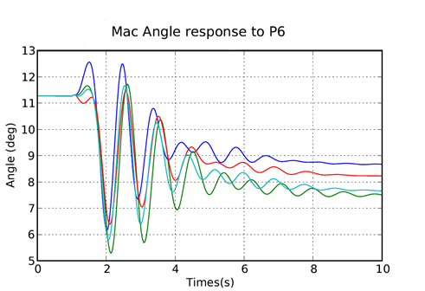
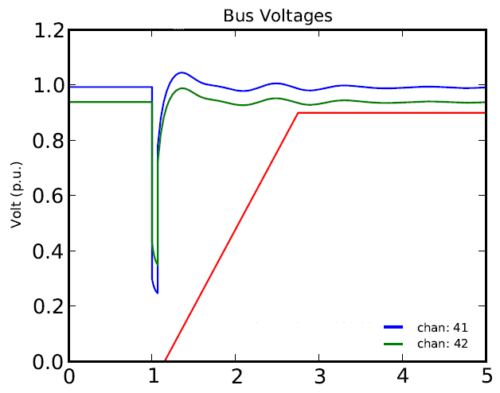
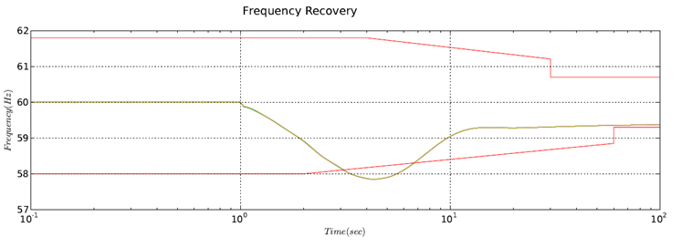
Dynamic Runs Results

Slide 39
Extreme Events and Misc. Studies
Extreme Events
Cascading Studies
Under Voltage Load Shedding
Under Frequency Load Shedding
Miscellaneous Studies
LVRT studies on new interconnection
HVRT studies on new interconnection
Small Signal Stability study
SSR studies

Slide 40

Questions?

